Slide 1
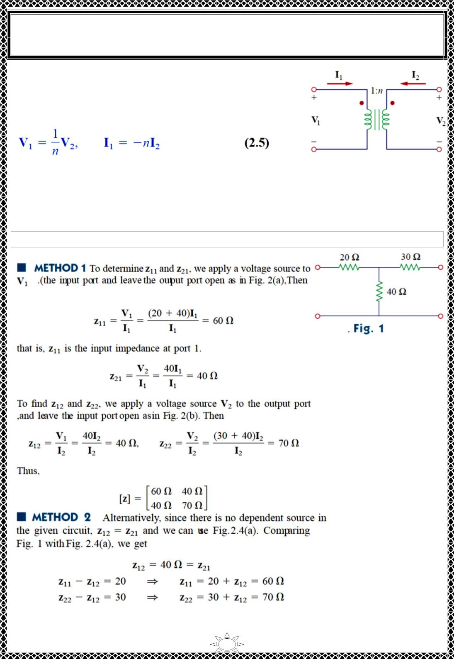
University of Diyala
Engineering College
Electronic Department
Electrical Circuits
2nd Class
Lecturer : Wisam N. AL-Obaidi
Year (2015-2016)
It should be mentioned that for some two-port networks, the z
parameters do not exist because they cannot be described by
Eq. (2.1). As an example, consider the ideal transformer of
Fig.2.5. The defining equations for the two-port network are:
Fig.2.5
Observe that it is impossible to express the voltages in terms of the currents, and vice
versa, as Eq. (2.1) requires. Thus, the ideal transformer has no z parameters. However, it
does have hybrid parameters.
Example 1: Determine the z parameters for the circuit shown.
Solution:
Trail Version
Trail Version
Trail Version
Trail Version
Trail Version
Trail Version
Trail Version
Trail Version
Trail Version
Trail Version
Trail Version
Trail Version
Trail Version
4

Slide 2
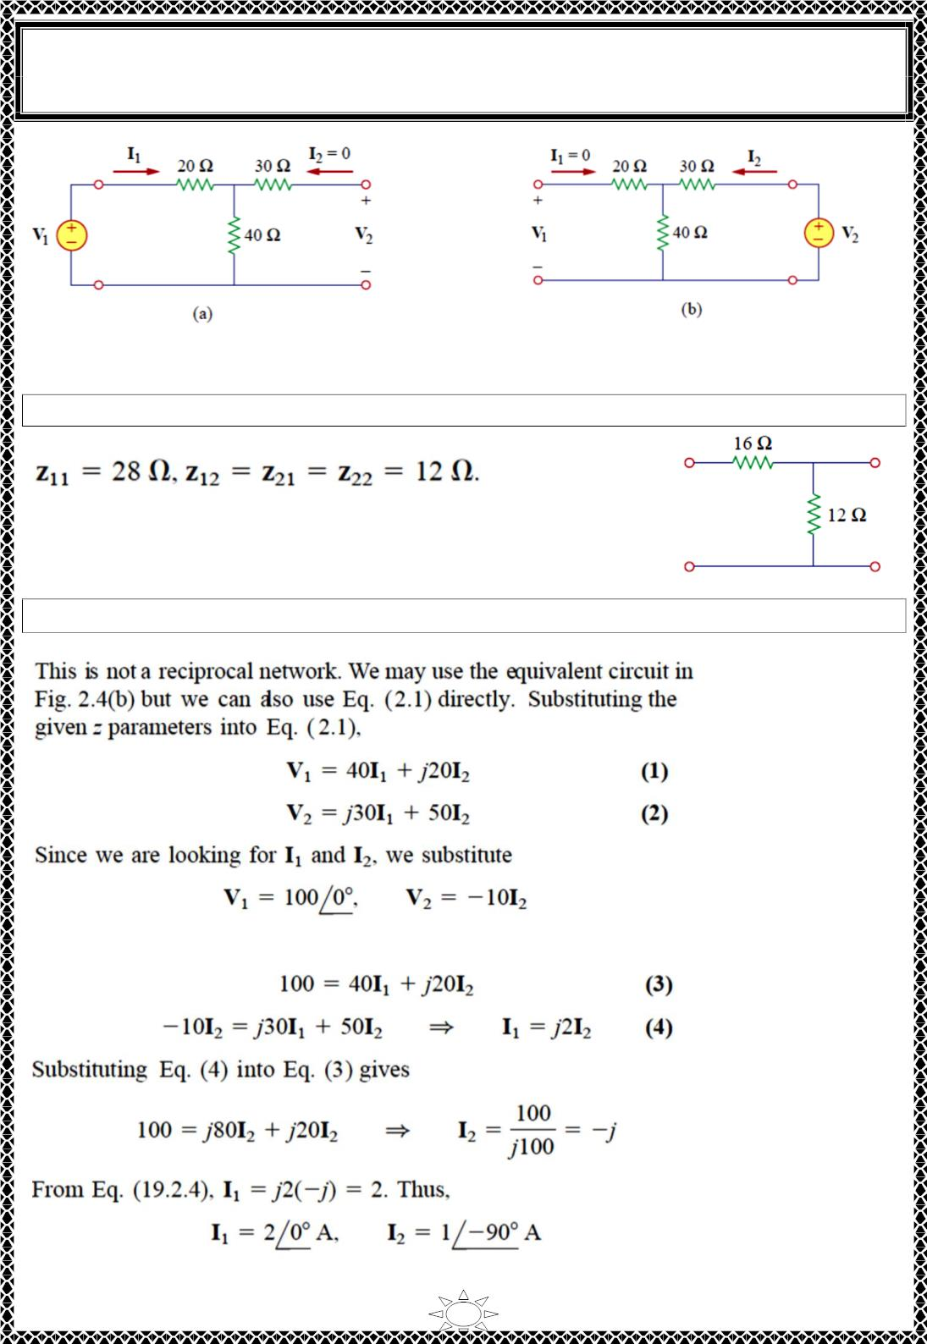
University of Diyala
Engineering College
Electronic Department
Electrical Circuits
2nd Class
Lecturer : Wisam N. AL-Obaidi
Year (2015-2016)
Fig.2 (a) finding z and z (b) finding z and z
22
11
21
12
H.W.1: Find the z parameters of the two-port network in Fig.
Answer:
Example 2: Find I1 and I2 in the circuit in Fig
Solution:
Trail Version
Trail Version
Trail Version
Trail Version
Trail Version
Trail Version
Trail Version
Trail Version
Trail Version
Trail Version
Trail Version
Trail Version
Trail Version
into Eqs. (1) and (2), which become
5

Slide 3
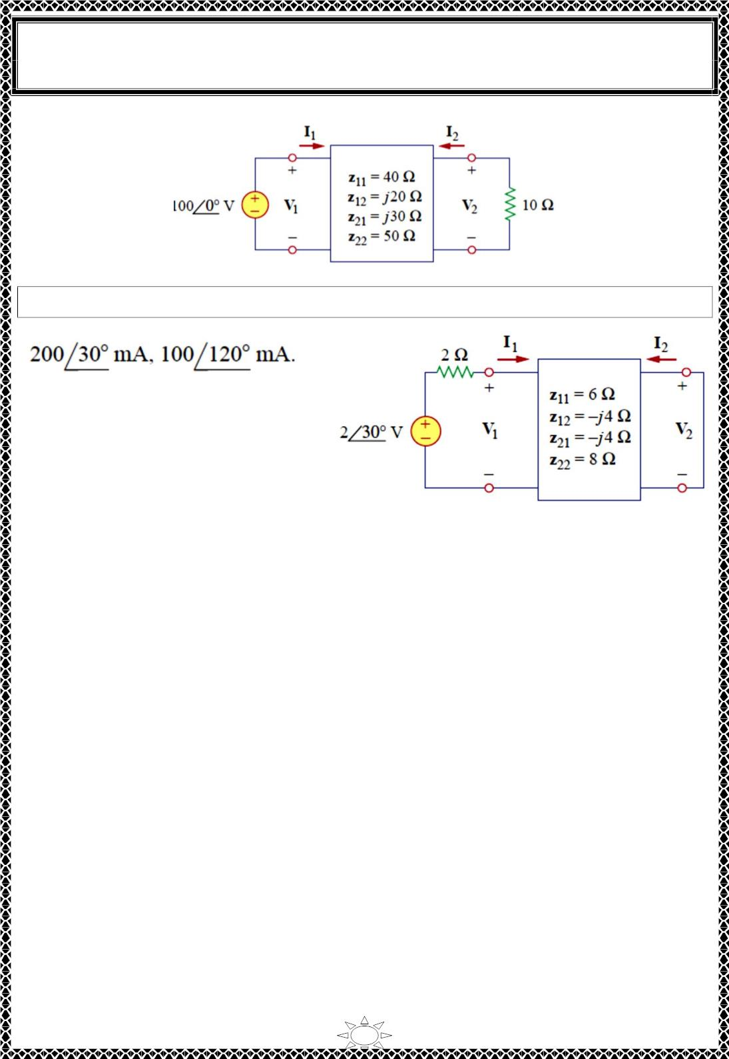
University of Diyala
Engineering College
Electronic Department
Electrical Circuits
2nd Class
Lecturer : Wisam N. AL-Obaidi
Year (2015-2016)
H.W.2: Calculate I1 and I2 in the two-port of Fig.
Answer:
Trail Version
Trail Version
Trail Version
Trail Version
Trail Version
Trail Version
Trail Version
Trail Version
Trail Version
Trail Version
Trail Version
Trail Version
Trail Version
6

Slide 4
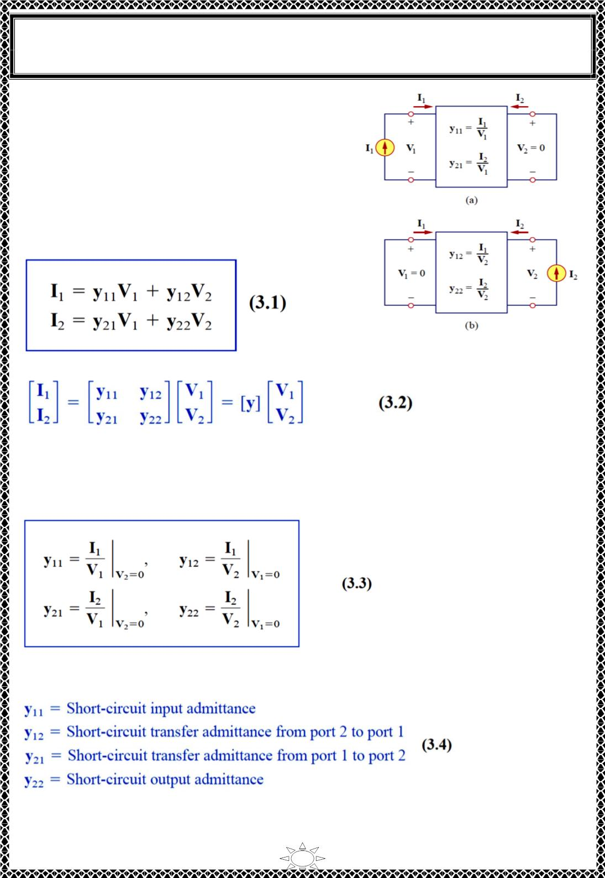
University of Diyala
Engineering College
Electronic Department
Electrical Circuits
2nd Class
Lecturer : Wisam N. AL-Obaidi
Year (2015-2016)
2) Admittance Parameters (y-parameters)
In the previous section we saw that impedance
parameters may not exist for a two-port network. So
there is a need for an alternative means of describing
such a network. This need may be met by the second
set of parameters, which we obtain by expressing the
terminal currents in terms of the terminal voltages. In
either Fig.3.1 (a) or (b), the terminal currents can be
expressed in terms of the terminal voltages as
Fig.3.1 Determination of the y parameters:
(a) finding y and y (b) finding y and y
22
11
21
12
Trail Version
Trail Version
Trail Version
Trail Version
Trail Version
Trail Version
Trail Version
Trail Version
Trail Version
Trail Version
Trail Version
Trail Version
Trail Version
The terms are known as the admittance parameters (or, simply, y parameters) and have units of
siemens.
The values of the parameters can be determined by setting V₁ = 0 (input port short-
circuited) or V₂ = 0 (output port short-circuited). Thus,
Since the y parameters are obtained by short-circuiting the input or output port, they are
also called the short-circuit admittance parameters. Specifically,
7

Slide 5
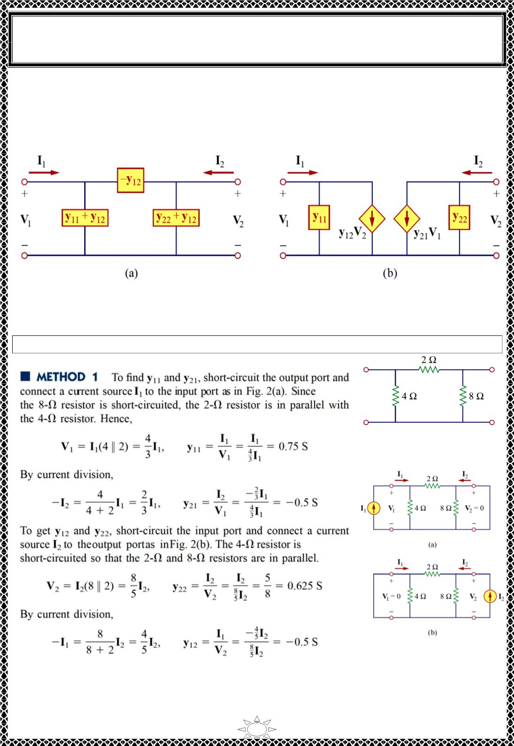
University of Diyala
Engineering College
Electronic Department
Electrical Circuits
2nd Class
Lecturer : Wisam N. AL-Obaidi
Year (2015-2016)
For a linear two-port network and has no dependent sources, the transfer admittances are
equal (y = y ). This can be proved in the same way as for the z parameters. A reciprocal
12
21
network (y = y ) can be modeled by the Π-equivalent circuit in Fig.3.2 (a). If the network
12
21
is not reciprocal, a more general equivalent network is shown in Fig.3.2 (b).
Fig.3.2 (a) Π-equivalent circuit (for reciprocal case only), (b) general equivalent circuit.
Trail Version
Trail Version
Trail Version
Trail Version
Trail Version
Trail Version
Trail Version
Trail Version
Trail Version
Trail Version
Trail Version
Trail Version
Trail Version
Example 3: Obtain the y parameters for the network shown in Fig.
Solution:
Fig.1
Fig.2
(a) finding y₁₁ &y₂₁
(b) finding y₁₂ and y₂₂
8

Slide 6
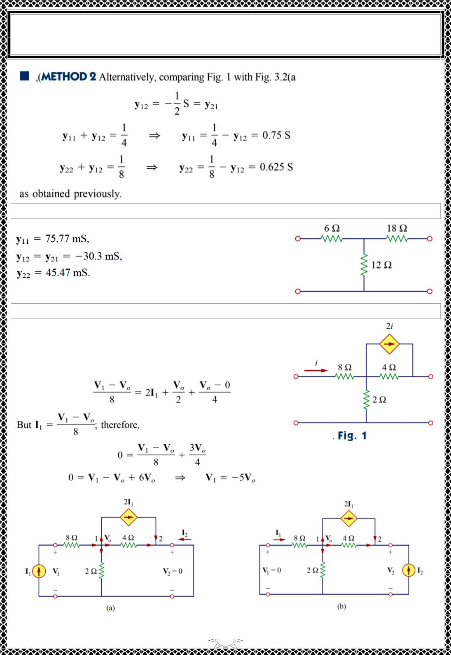
University of Diyala
Engineering College
Electronic Department
Electrical Circuits
2nd Class
Lecturer : Wisam N. AL-Obaidi
Year (2015-2016)
H.W.3: Obtain the y parameters for the T network shown in Fig.
Answer:
Trail Version
Trail Version
Trail Version
Trail Version
Trail Version
Trail Version
Trail Version
Trail Version
Trail Version
Trail Version
Trail Version
Trail Version
Trail Version
Example 4:Determine the y parameters for the two-port shown
Solution: We follow the same procedure as in the
previous example. To get y -and y , we use the circuit in
11
21
Fig. 2 (a), in which port 2 is short circuited and a current
source is applied to port 1. At node 1,
Fig.2 (a) finding y &y (b) finding y and y
11
21
12
22
9

Slide 7
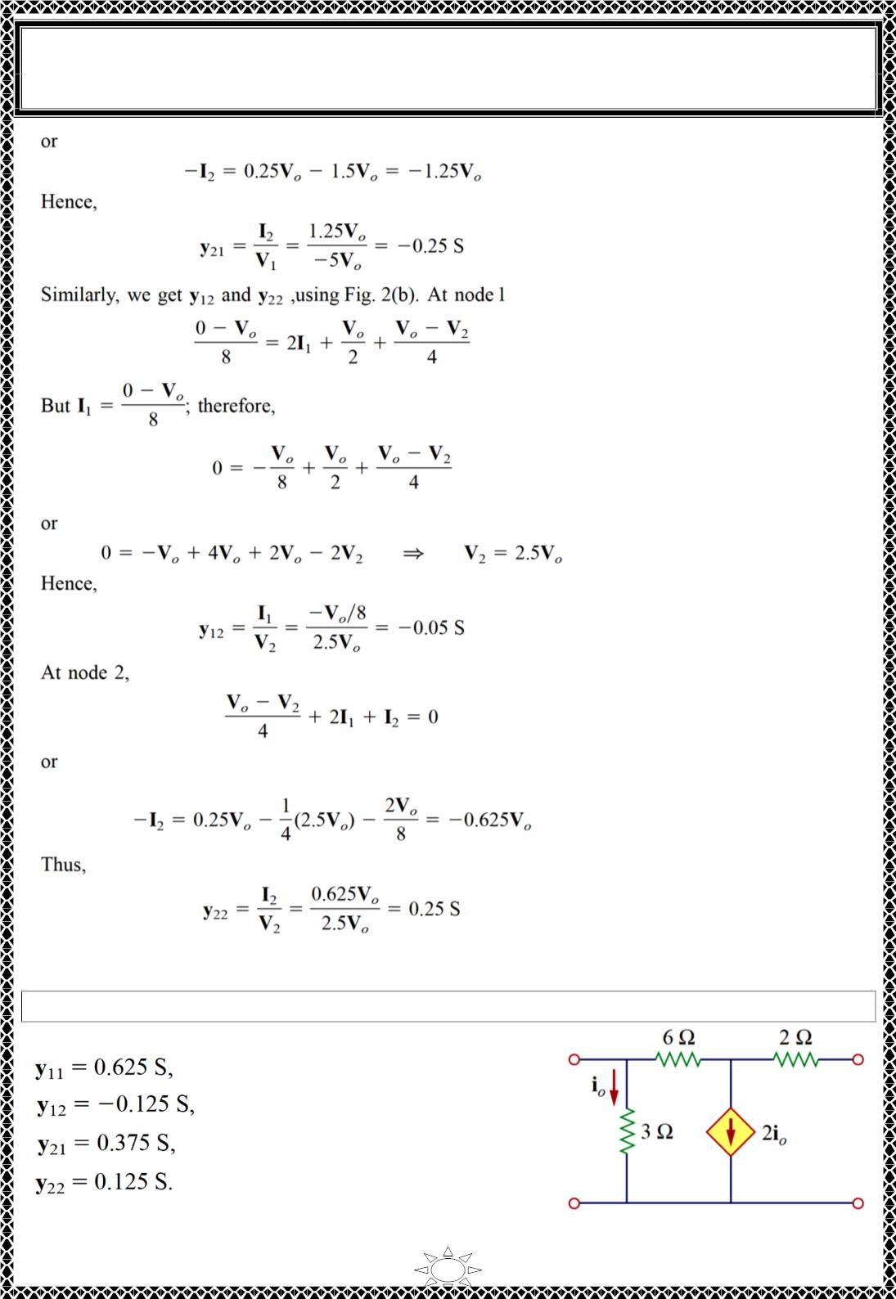
University of Diyala
Engineering College
Electronic Department
Electrical Circuits
2nd Class
Lecturer : Wisam N. AL-Obaidi
Year (2015-2016)
Trail Version
Trail Version
Trail Version
Trail Version
Trail Version
Trail Version
Trail Version
Trail Version
Trail Version
Trail Version
Trail Version
Trail Version
Trail Version
Notice that y ≠ y in this case, since the network is not reciprocal.
12
21
H.W.4: Obtain the y parameters for the circuit in Fig.
Answer:
10

Slide 8
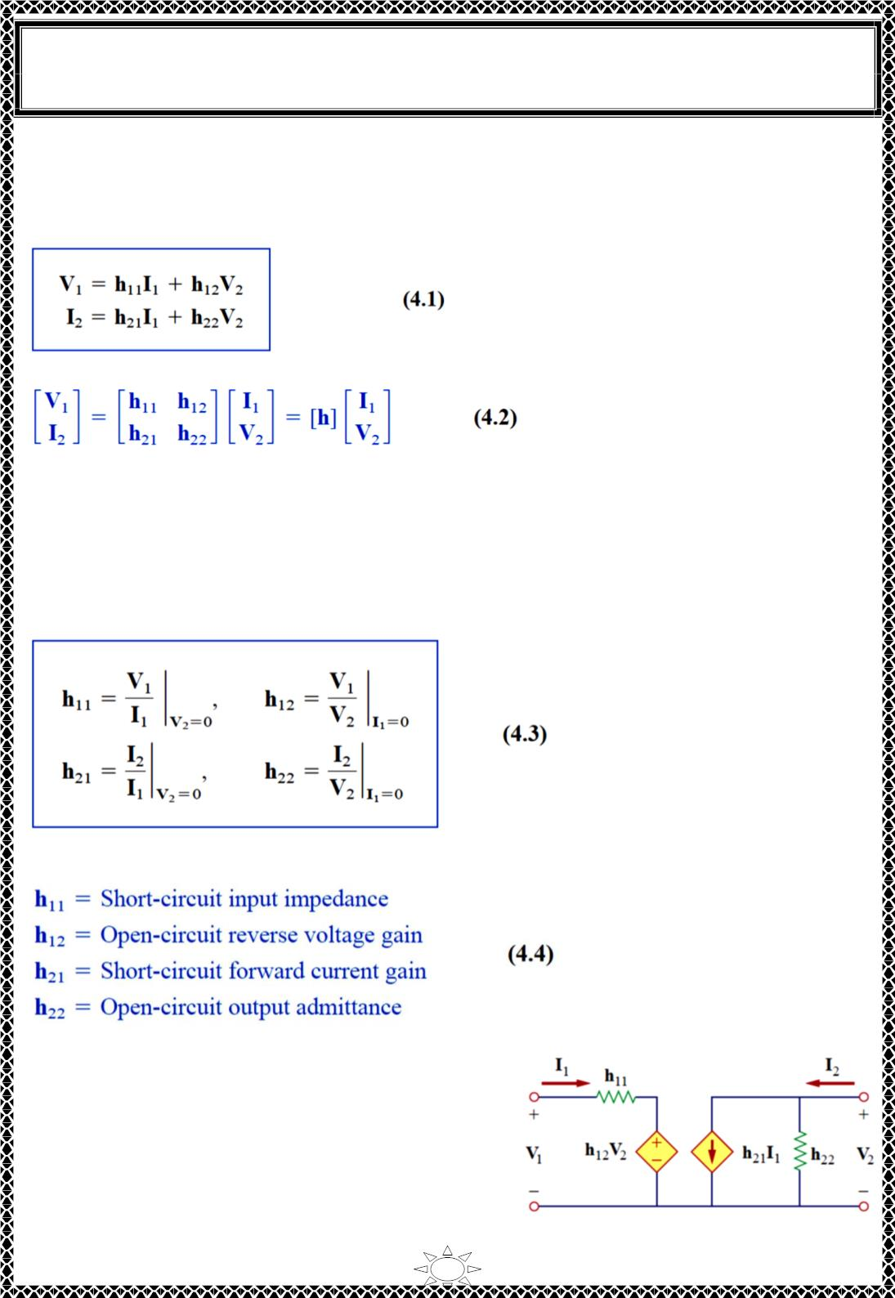
University of Diyala
Engineering College
Electronic Department
Electrical Circuits
2nd Class
Lecturer : Wisam N. AL-Obaidi
Year (2015-2016)
3) Hybrid Parameters (h-parameters)
The z and y parameters of a two-port network do not always exist. So there is a need for
developing another set of parameters. This third set of parameters is based on making V₁
and I₂ the dependent variables. Thus, we obtain
or in matrix form
The h terms are known as the hybrid parameters (or, h parameters) because they are a hybrid
combination of ratios. They are very useful for describing electronic devices such as
transistors; it is much easier to measure experimentally the h parameters of such devices
than to measure their z or y parameters.
In fact, we have seen that the ideal transformer in Fig. 2.5, described by Eq. (2.5), does not
have z parameters. The ideal transformer can be described by the hybrid parameters,
because Eq. (2.5) conforms with Eq. (4.1). The values of the parameters are determined as
Trail Version
Trail Version
Trail Version
Trail Version
Trail Version
Trail Version
Trail Version
Trail Version
Trail Version
Trail Version
Trail Version
Trail Version
Trail Version
The parameters h , h , h and h , represent an impedance, a voltage gain, a current
11
12
21
22
gain, and an admittance, respectively. This is why they are called the hybrid parameters.
The procedure for calculating the h parameters is similar to that used for the z or y
parameters. We apply a voltage or current source to
the appropriate port, short-circuit or open-circuit the
other port, depending on the parameter of interest,
and perform regular circuit analysis. For reciprocal
networks, h = −h . This can be proved in the
12
12
same way as we proved that z = z . Fig. 4.1
12
12
shows the hybrid model of a two-port network.
Fig. 4.1 The h-parameter equivalent
11
network of a two-port network.

Slide 9
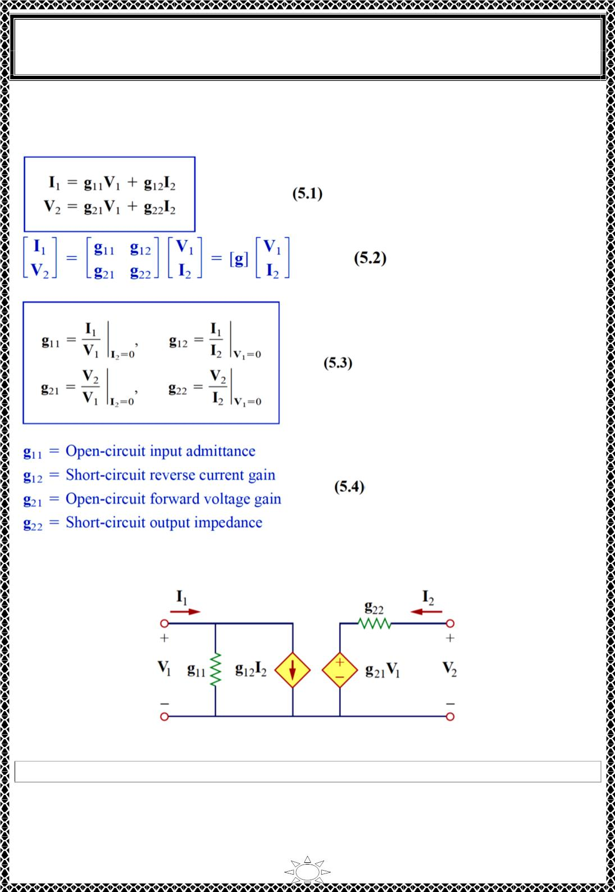
University of Diyala
Engineering College
Electronic Department
Electrical Circuits
2nd Class
Lecturer : Wisam N. AL-Obaidi
Year (2015-2016)
4) Inverse Hybrid Parameters (g-parameters)
A set of parameters closely related to the h parameters are the g parameters or inverse hybrid
parameters. These are used to describe the terminal currents and voltages as
The values of the g parameters are determined as
Trail Version
Trail Version
Trail Version
Trail Version
Trail Version
Trail Version
Trail Version
Trail Version
Trail Version
Trail Version
Trail Version
Trail Version
Trail Version
Thus, the inverse hybrid parameters are specifically called
Fig. 5.1 shows the inverse hybrid model of a two-port network. The g parameters are
frequently used to model field-effect transistors.
Fig. 5.1 The g-parameter model of a two-port network.
Example 5: Find the hybrid parameters for the two-port network of Fig. 1
Solution:
To find h and h , we short-circuit the output port and connect a current source I to the
11
21
1
input port as shown in Fig.2(a).
12

Slide 10
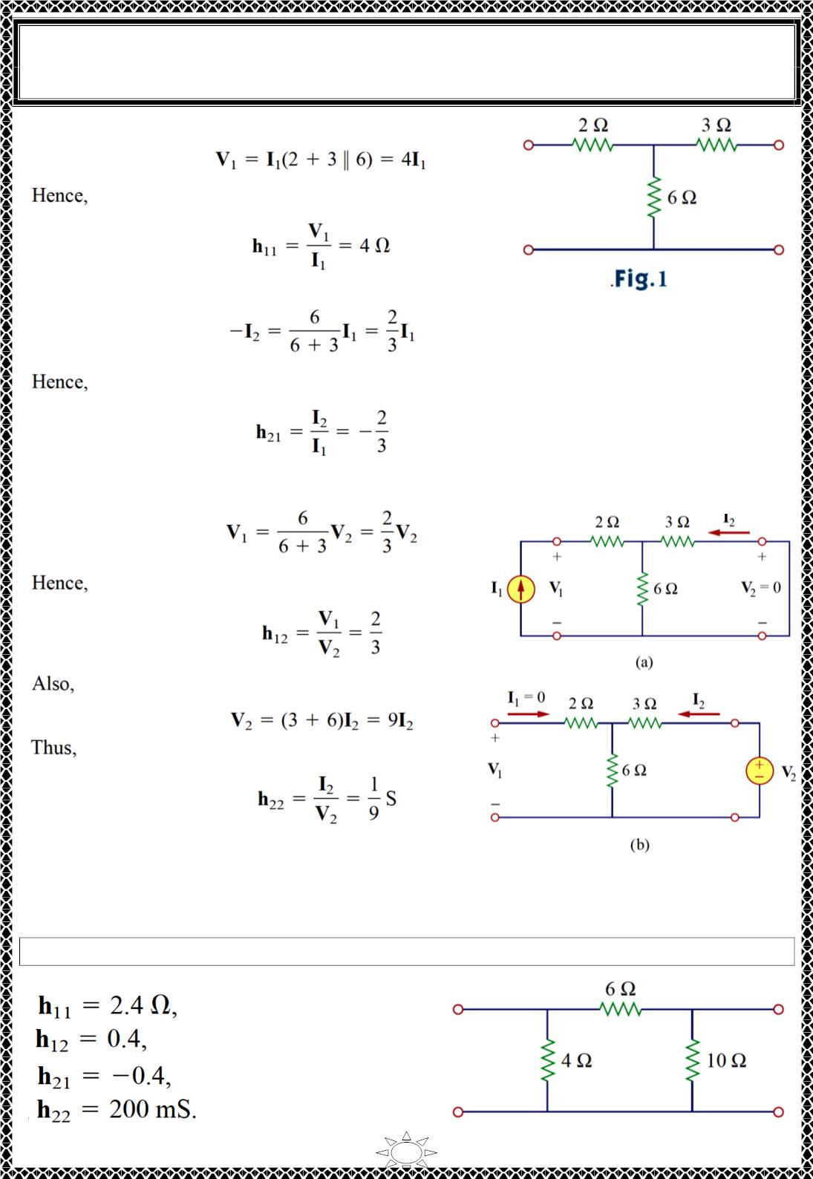
University of Diyala
Engineering College
Electronic Department
Electrical Circuits
2nd Class
Lecturer : Wisam N. AL-Obaidi
Year (2015-2016)
∴ From Fig. 2(a),
Also, from Fig. 2(a) we obtain, by current division,
To obtain h and h , we open-circuit the input port and connect a voltage source V to the
12
22
2
output port as in Fig.2(b). By voltage division,
Trail Version
Trail Version
Trail Version
Trail Version
Trail Version
Trail Version
Trail Version
Trail Version
Trail Version
Trail Version
Trail Version
Trail Version
Trail Version
Fig. 2 (a) computing h and h ,
11
21
(b) computing h and h .
12
22
H.W.5: Determine the h parameters for the circuit in Fig.
Answer:
13

